Slide 1


The effects of the Avancemos Conditional Cash Transfer Program in Costa Rica, evaluation using Machine Learning
by: Ricardo Murillo Rapso
Relatore: Prof. Silvia Salini
Correlatore: Prof. Giancarlo Manzi

Slide 2
Objective of the thesis
Evaluate the impact of the Conditional Cash Transfer (CCT) policy Avancemos on child labor using Machine Learning methods.

Slide 3
Avancemos Program
CCT program that started in 2006.
Prevents High School dropout.
Covers more than 90% of the target pop. each year.

Slide 4
Methodology
Data handling.
Identification Strategy.
Modelling DML.

Slide 5
Data Handling
Data Description.
Imputation of Missing Values.
Transformations.

Slide 6
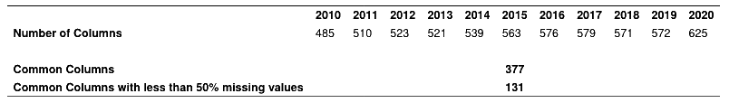
Data Description
2010-2020 National Household Survey.
Common Column Selection.
Income, labor, education, housing, social security and demographics.

Slide 7
Imputation of Missing Values
Missing not at random.
114 cat. & 17 num.
Iterative Imputation.

Slide 8
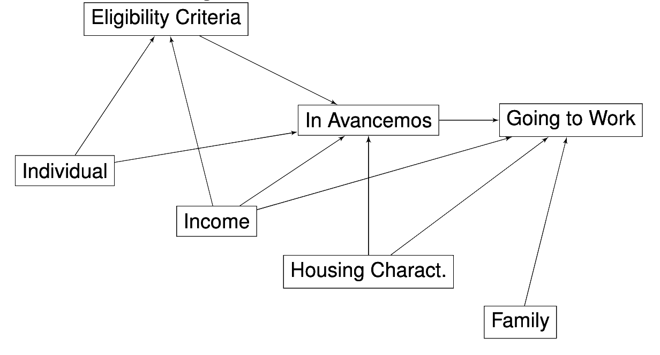
Identification Strategy
Elegibility of Avancemos.
Spread of the Program is high.
Average Treatment Effects.
treatment
outcome

Slide 9
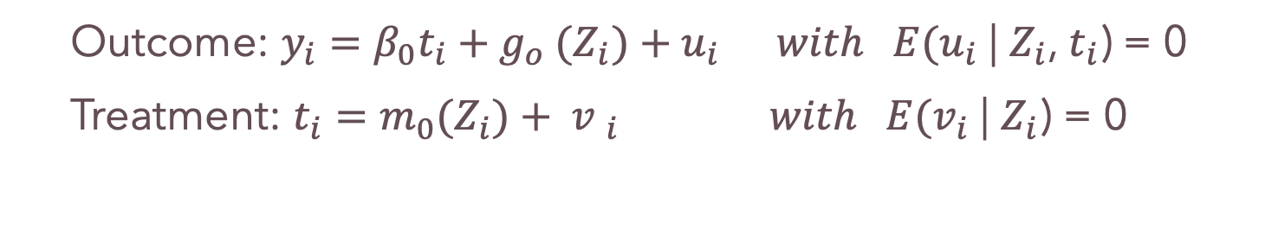
Identification Strategy
Outcome: $y_{i}=β_{0}t_{i}+g_{o} {(Z}_{i})+u_{i} with E(u_{i}$ | $Z_{i}$, $t_{i}$) = 0
Treatment: $t_{i}=m_{0}{(Z}_{i})+ {v }_{i}$ $with E(v_{i}$ | $Z_{i}$) = 0

Slide 10

Steps to follow
Use ML to predict the outcome:
$Y from z →u=y − {\hat{g}}_{0}(Z)$
Use ML to predict the treatment:
t$from z →v=t − {\hat{m}}_{0}(Z)$
Regress the residuals to get the treatment effect:
$y −\hat{y} on t −\hat{t} →ATE={\hat{β}}_{0}$

Slide 11
Double Debiased M.L.
Orthogonalization.
Sample Splitting and Cross Fitting.
Spread of the Program is high.

Slide 12
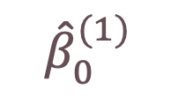
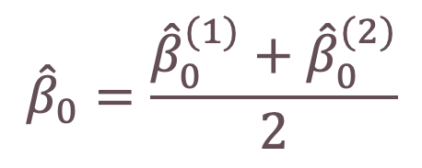

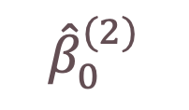
Sample Splitting and Cross Valid.
Random Split
Training Data
Estimation Data
$${\hat{β}}_{0}^{(1)}$$
$${\hat{β}}_{0}^{(2)}$$
Estimation Data
Training Data
Training Data used to fit the nuisance parameters.
Estimation Data used only to estimate $β$ .
This is done k times for added robustness.
$${\hat{β}}_{0}=\frac{{\hat{β}}_{0}^{(1)}+{\hat{β}}_{0}^{(2)}}{2}$$

Slide 13
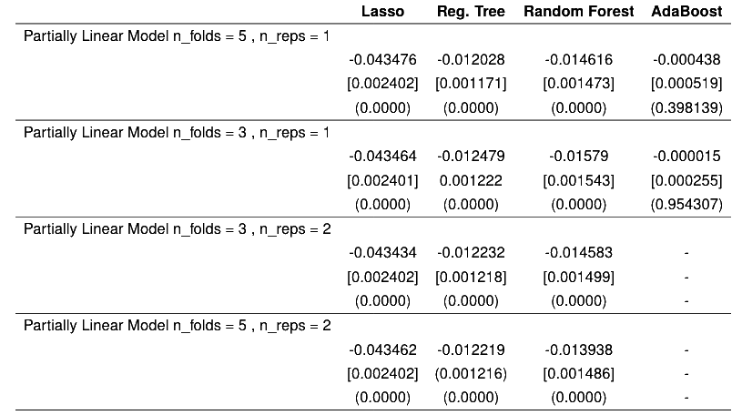
Key Results

Slide 14
Contributions and Implications
Effect of the program is positive on reducing the probability.
Lasso type model works best with large amounts of cofounders.
Effects are lower than other investigations that use less cofounders.
CCT programs could benefit from better evaluation.
Policy Evaluation with ML is incipient and could be promising.

